Slide 1
Chapter 5 – Count Controlled Loops FOR
By the end of this chapter you should:
Understand the how to structure a FOR loop
Know when it is more suitable to use FOR rather than DO or WHILE

Slide 2
What is an FOR loop?
A FOR loop has a different syntax to the other loops, it’s all controlled by the top statement and has a counter built in
This is probably the most commonly used of all the loops
It’s very useful if you know how many iterations of the loop you will need
It is also useful if you want to count through a fixed set of values, like a list of data/ an array (but more about those next chapter!)

Slide 3
Example 1
This starts the loop counting from 0
The loop will continue WHILE X is less than 10
This will add one to x each time the For loops
for( x=0; x<10; x++)
{
printf(“Enter number %d: \n", x+1); scanf(“%d”, &num);
}
The loop counter is often used to do something inside the loop – in this example it’s displaying the loop counter plus one, which is used in the output
The program would loop through and print:
Enter number 1: Enter number 2:….etc. up to
Enter number 9:
And would stop when the FOR counter reaches 10

Slide 4
Example 2
This starts the loop counting from 100
The loop will continue WHILE X is 1 or more
This will subtract ten from x each time the FOR loops
for (x=100 ; x>0 ; x=x-10)
{
printf(“X is %d \n ",x);
}
The program would loop through and print:
X is 100
X is 90
X is 80 etc….

Slide 5
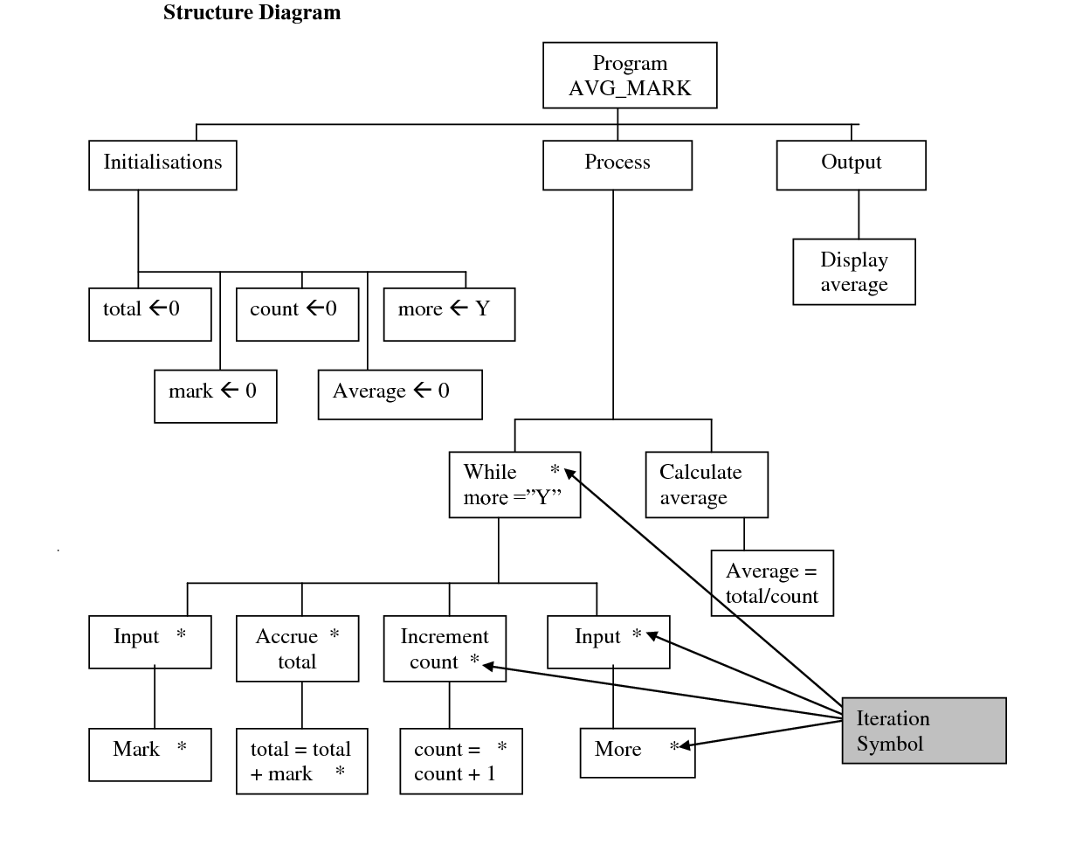
Structure Charts Re-visited

